Slide 1
IT & Systems
Induction Presentation

Slide 2
Content
1
2
3
Infrastructure
Applications
Policies

Slide 3
Content
1
2
3
Infrastructure
Applications
Policies

Slide 4
Team
1
Hariharan
(Head-IT & Systems)
Dhirendra Singh
(IT Facilities & Support)
Lalit Gupta
(HR, Engineering Applications)
Veena
(ERP Applications)
Vinay
(Helpdesk Support)
Bhupender
(E-mail Support)
Praveen
(IT Security)
Pankaj Gupta
(ERP Support)

Slide 5
Technology
1
HRIS
ERP
PLM
CAD
Apps
DMS
Intranet
…

Slide 6
Content
1
2
3
Infrastructure
Applications
Policies

Slide 7
Content
1
2
3
Infrastructure
Applications
Policies

Slide 8
Business Application (BaaN ERP)
2
ERP Not used/No Automation
Customer Billing, Schedule & Status
MIS Creation
ERP Supports Operation
ERP Drives Operation
SAR/QFR
Vendor Quality Tracking
Cash Flow
Element wise Sanction Utilisation & Monitoring
Payment Tracking
Payments
Vendor/Customer Document Management
Material Despatch & Receipt at Site
Delivery Tracking
Project Sanction Control
Engineering Document Release & Change Control
Delivery Sequence Control
Order Placement
Export Invoicing
Planned to be integrated
Resource &
Productivity Management
Material Indenting
Historic Cost Comparison
Domestic Invoicing
Design Development Planning
Planning
Enquiry
Accounting
Engg. & Design
Projects
Procurement
Construction
Accounts

Slide 9
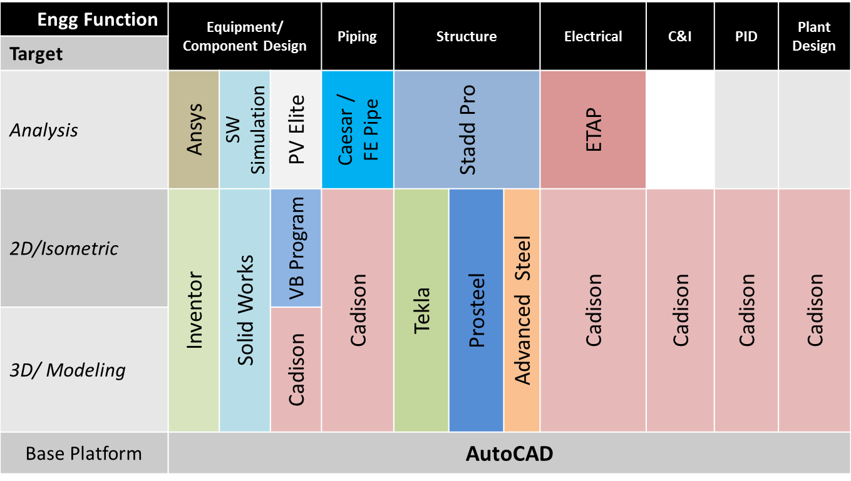
CAD Applications
2
E
D
I
iDMS/PLM-ERP
(Drawings Master List and BoM)

Slide 10
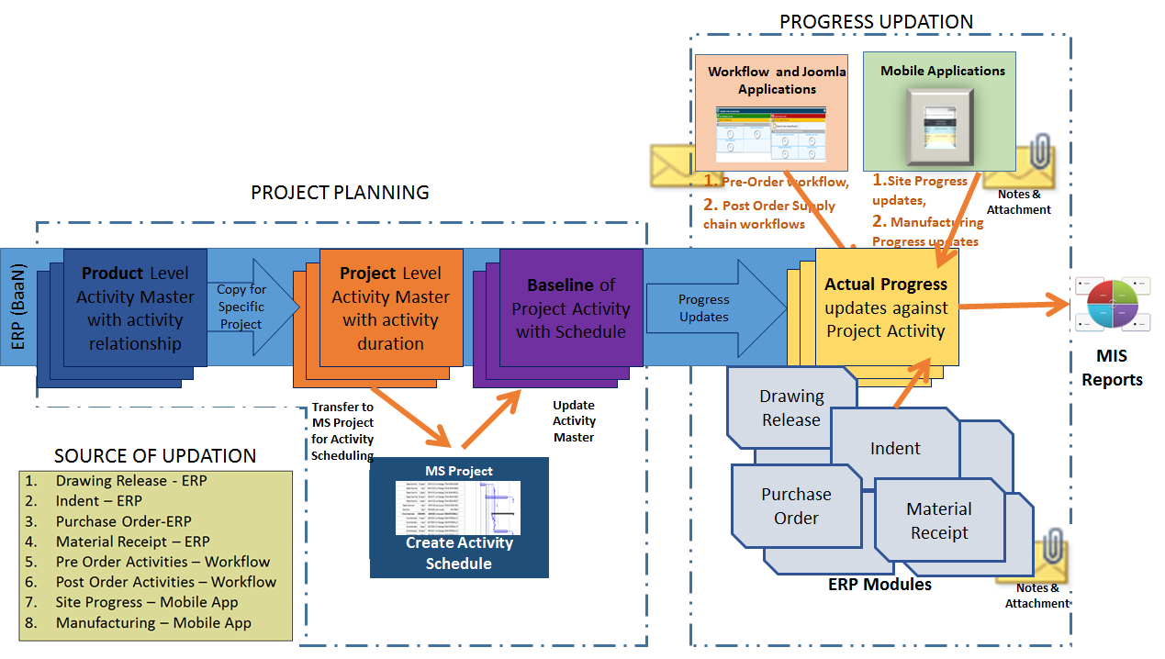
Project Control Tower
2

Slide 11
Content
1
2
3
Infrastructure
Applications
Policies

Slide 12
Content
1
2
3
Infrastructure
Applications
Policies

Slide 13
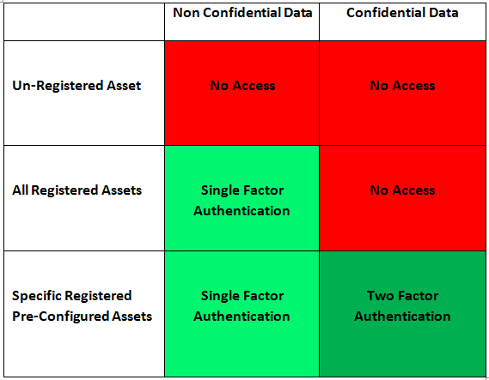
Security Policy
3

Slide 14
IT Guidelines on Information Security
3
IT Information Security Procedure
Surveillance of Internet Access
Handling of SPAM/Phishing Mails
Instruction for using Correct E-Mail Address and Signature
Fowarding of mails to personal e-mails IDs
IT Guidelines for Data Backup
IT Guidelines for Travelling Users

Slide 15
Welcome Mail

Slide 16
End of Report

